Slide 1
INTRODUCTION TO TELEPHONY
EEEN 464 – DIGITAL COMMUNICATION
Tuesday, June 3, 2025

Slide 2
WHAT IS TELEPHONY?
Telephony is the technology associated with the electronic transmission of voice, fax, or other information between distant parties using systems historically associated with the telephone.
Telephone: A handheld device containing both a speaker or transmitter and a receiver.
IP telephony (Internet Protocol telephony) is a general term for the technologies that use packet-switched connections to exchange voice, fax, and other forms of information that have traditionally been carried over the dedicated circuit-switched connections of the public switched telephone

Slide 3
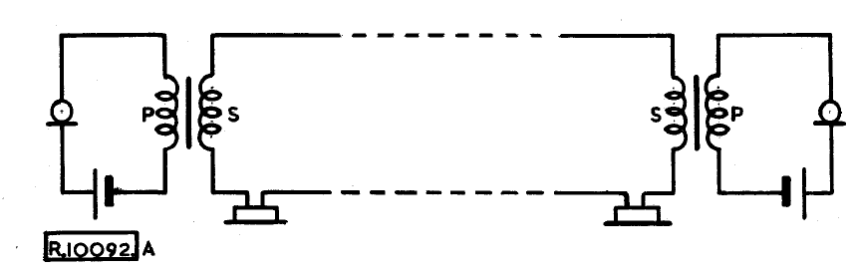
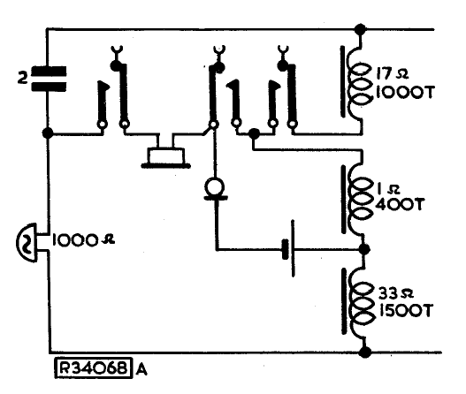
SIMPLE LOCAL BATTERY SYSTEM – THE ORIGINAL TELEPHONE SYSTEM
Microphone
Earphone

Slide 4
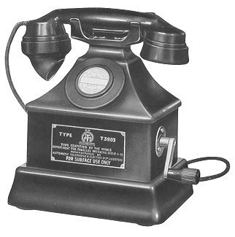

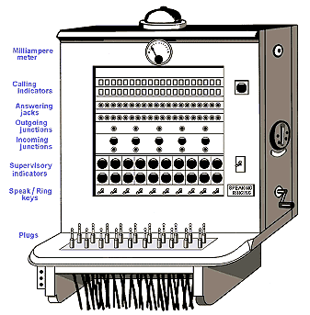
ELEMENTS OF A LOCAL BATTERY SYSTEM
Pair of Copper Wires
Contents:
1, Ear Piece
2. Mouth Piece
3. Ringer/Bell
4. Magneto Generator

Slide 5
BASIC SWITCHING NETWORK
N Inlets
SWITCHING
NETWORK
M Outputs
M=N : Symmetric Network
Incoming
Trunks
SWITCHING
NETWORK
Outgoing
Trunks
Subscriber
Inputs
Subscriber
Outputs

Slide 6
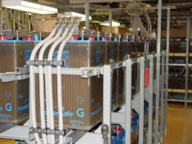
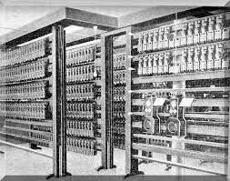
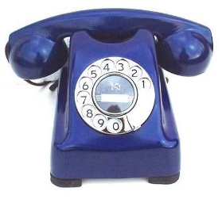

CENTRAL BATTERY SYSTEMS
Power Room
Rectifiers
Generator
Battery Banks
Copper Bus-bars
$L ≤$4 kms
Pair of Copper Wires
Dial Telephone
Telephone Exchange Room

Slide 7
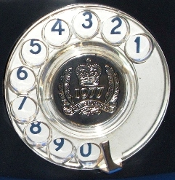
PULSE DAILING
4
3
2
1

Slide 8
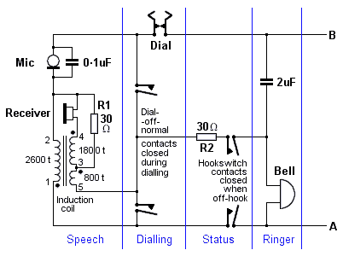
PULSE TONE TELEPHONE CIRCUIT

Slide 9
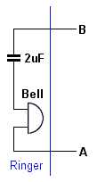
RINGER
When the telephone is on-hook the hook-switch contacts are open, and only the bell is connected across the line.
The 2μF capacitor blocks dc
Exchange sends 75v (rms) at 17 Hz to the line to ring the bell.

Slide 10
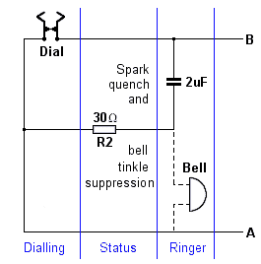
DIALING
The rotary dial transmits number to the exchange as a sequence of pulses by repeatedly making and breaking the line.
The series RC network connected across the impulse contacts modifies the pulse shape, prevents arcing at the contacts and also mutes the bell.

Slide 11
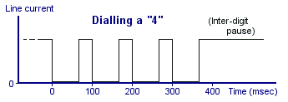
PULSE TIMING DIAGRAM
The dial is supposed to deliver 10 pulses per second (but the exchange equipment was designed to accept anything between 7 and 12 pulses/sec) at a make/break ratio of 1:2.
The actual value of line current flowing would depend on the length of the line back to the exchange and the state of the exchange battery(35 to 140 mA).

Slide 12
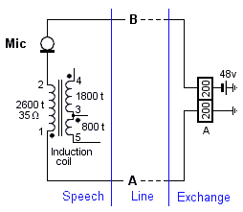
HOLDING CIRCUIT
When the user picks up the handset, current begins to flow in the line. The 'A' relay at the exchange operates.
When the call ends, relay is released.

Slide 13
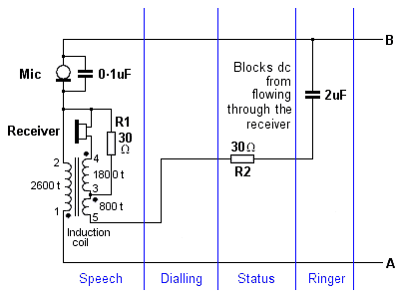
THE SPEECH CIRCUIT
Functions:
Move all the signal power generated in the microphone out to the line.
Move all the signal power delivered by the line into the receiver.
Prevent any power being generated by the microphone from reaching the receiver.

Slide 14
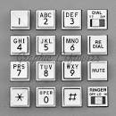
DIAL/TOUCH-TONE PHONE
Dial-Pulse Phone
Touch Tone Phone

Slide 15
TOUCH TONE TELEPHONE
1209
1336
1477
1
2
3
697
4
5
6
770
Lower Band Frequency (Hz)
7
8
9
852
*
8
#
941
Upper Band Frequency (Hz)

Slide 16
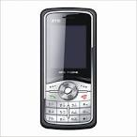
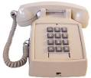
ADVANTAGES OF TOUCH-TONE
Higher speed of dialing
Support for End-to-End signaling
Surveillance
Camera
Bomb
Trigger, etc
074576890
PSTN
PABX
PABX
+256-567890
072376890
Ext. 340

Slide 17
TOUCH-TONE DIAL TELEPHONE
Advantages of Touch-tone dialing:
Shorter time taken to dial compared with pulse dialing which took 12 sec to dial a 7-digit number.
Equipment in common control switching systems are not tied up for the whole duration of the call.
End to end signaling is possible since the touch-tone-dialing works in the voice frequency band.
Using push button instead of a dial in more convenient to the user.
By using a combination of two sets of frequencies, touch tone can support a wider number range and more characters.

Slide 18
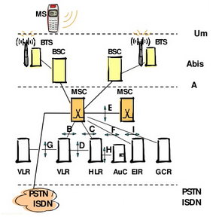
GSM NETWORK ARCHITECTURE
Mobile Station (MS)
Base Transceiver
Station (BTS)
Base Station
Controller (BSC)
Mobile
Switching
Centre (MSC)
Equipment
Identity
Register (EIR)
Group Call Register
Visitor
Location
Register
Home
Location
Register
Authentication
Centre (AuC)

Slide 19
MOBILE STATION/PHONE
Mobile Station consists of two parts:
1. Subscribe Identity Module contains:
Subscriber related information
PIN and PUK codes.
Network access information
SIM card can be updated over the air.
2. Mobile Equipment containing the phone hardware and firmware.

Slide 20
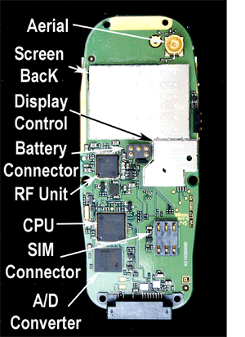
INSIDE A GSM MOBILE PHONE /01

Slide 21
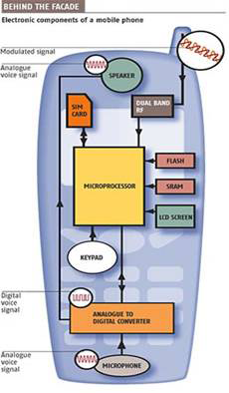
INSIDE A GSM MOBILE PHONE /02
Antenna
Speaker
Dual Band
RF Stage
SIM Card
Microprocessor
SRAM
LCD Screen
Display
Keyboard
ADC/DAC
converters
Microphone

Slide 22
INSIDE A GSM MOBILE PHONE /02
Antenna
Speaker
Dual Band
RF Stage
SIM Card
Microprocessor
SRAM
LCD Screen
Display
Keyboard
ADC/DAC
converters
Microphone

